Slide 1
稽阳联考

Slide 2
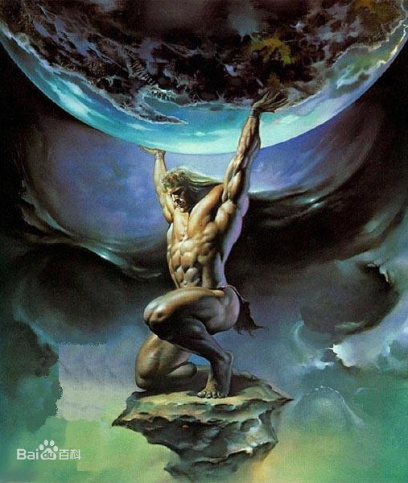
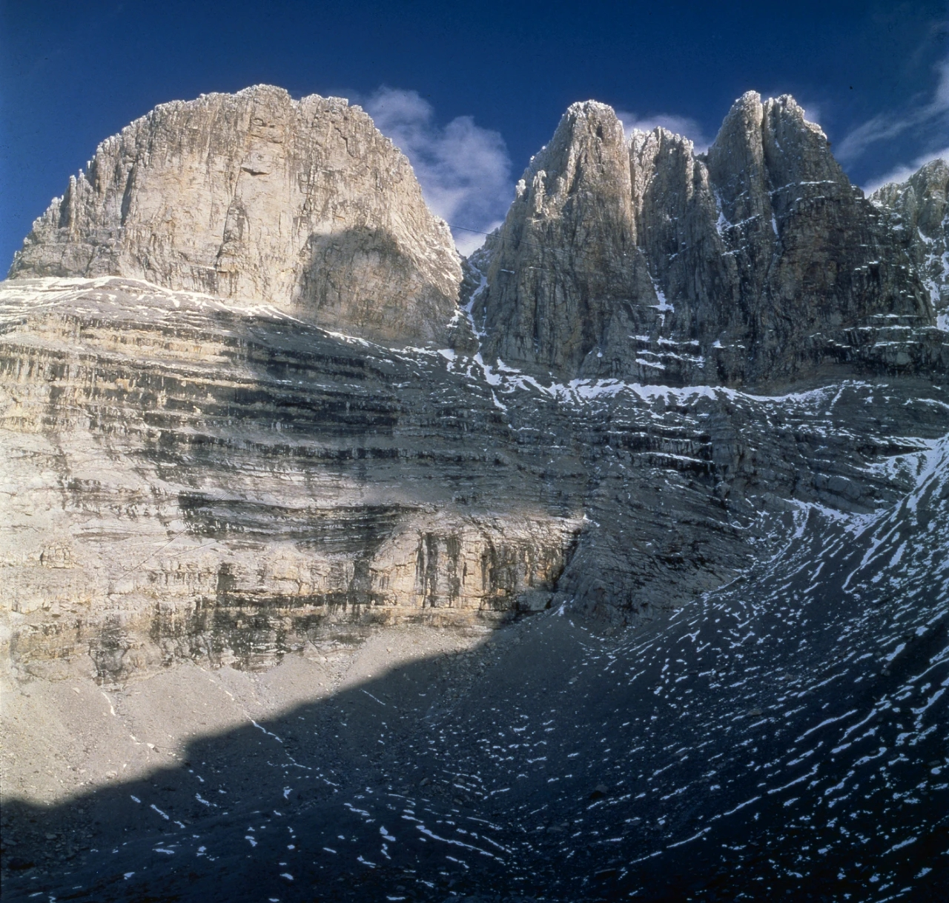
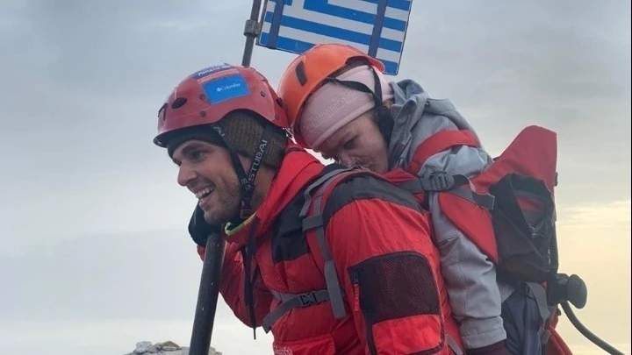
A篇
Atlas, a figure from ancient Greek myth, ____________________________________
_________.
single-handedly held the heavens high up
in the air
那天晚上那个老人凭一己之力解决了动物园的危机
It was the old man that single-handedly solved the crisis of the zoo
at that night.
Courageous
C__________(courage) Giannakos, an i________ 鼓舞人心的modern-day version of Atlas, carried a d_______ c__________ (company)to Mount Mytikas, thus helping to f____ her dream.
H_____ exist in real life as well.
inspiring
disabled
ompanion
fulfill
Heroes

Slide 3
With Torsion __________(fasten) in a secially adapted backpack, Giannakos, along with an eight-member support team, startd the ____________(exhaust) uphill climb of the ...tallest summit.
There is ________ more real than the dream.
没有比今天晚上经历的更刺激的了
It's ____________激动人心的to know that while we generally _________________把英雄想象成stuff of myth and legend, there are actually some ______________闪光的例子 --like Giannakoes--who exist in real life as well.

Slide 4
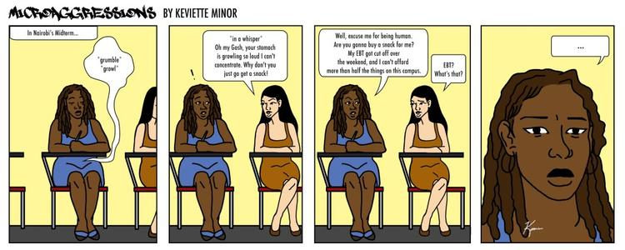
B篇
Paras.1-2: Microaggressions are being e_________ and s_____ about.
Para.3: Microaggressions are _______ physically and mentally.
Paras.4-5: Walker advised the victims _____ their opinions ______.
experienced
spoken
harmful
voice
frankly
WORD BANK
1. 鉴于种族骚乱
2. 接触种族歧视
3. 并无恶意

Slide 5
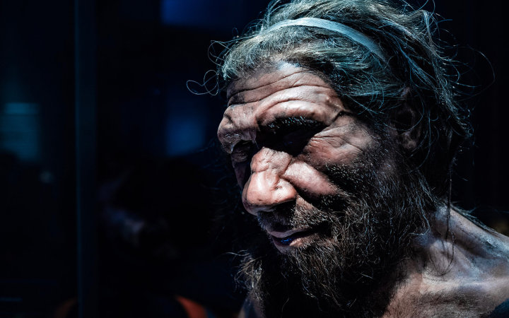
Global Warming
C篇
_______________ Drove Some
Neanderthals to Cannibalism
WORD BANK
1. 之前的研究
2. 绝非...独有
3.发现；明白
Six Neanderthals who lived in _____ is now now France were eaten by their fellow Neanderthals some100，000 years ago.
The researchers examined a layer of sediment in a cave________(know) as Baum Moula-Guercy... In that layer, charcoal and animal bones were ______ well-preserved that scientists could reconstruct an environmental picture___________（present) 120.000 to 130.000 years ago.

Slide 6
WORD BANK
1. 起初(单词) 2. 不太知道、了解 3. 情况并非总是如此
He had Laura feel an item, such as a spoon, and then ran her finger over a label that had the word spoon ________(spell) in ________(raise) letter.

Slide 7

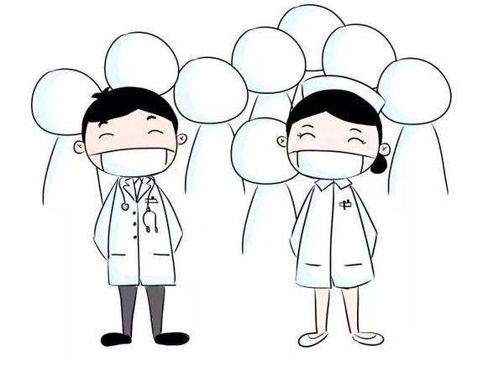
完形
upset/ sorrow-stricken
Seeing his daughter ____________________ 伤心的by the __________取消 of the graduation ceremony, Burdon managed to ________ one in their own yard ____________________她不知晓的情况下. What he did not only _______ her dream, but also made himself _______.
cancellation
host/make it up
without her knowledge
fulfilled
proud

Slide 8
WORD BANK
1. 六个星期期间
2. 它符合防疫标准，所有人戴口罩间隔6英尺就坐。
3. 这是我期待中最好的了/我别无他求。

Slide 9
THANKS

